Slide 1
Rendering and setState
APPLESEEDS

Slide 2
/TABLE OF CONTENTS
/01
What is rendering?
/02
Forcing rendering
/03
/04
Form demo
Multiple states together
APPLESEEDS
Is it happening automatically?
Rendering using useState
Multiple states, single state
demo

Slide 3
/01
What is rendering?
APPLESEEDS
INDEX.HTML

Slide 4
What is rendering?
APPLESEEDS
“Rendering” is defined as showing the elements you write in your code on the screen.
If you look at your code, you can see that we call a render function inside main.jsx
This basically takes all the objects you create with jsx, looks for diff, and if there is - show the diff on the screen

Slide 5
What is rendering?
APPLESEEDS
What if something inside our component is changing?
For example: let title; <h1>{title}</h1> <button onClick={()=>{title=”hi”}}>change</button>
Try it!

Slide 6
What is rendering?
APPLESEEDS
Why is this happening?
By default, react components are created once. Then we create a representation of them as a tree of objects (virtual DOM)
React, by default, doesn’t re-render (and thus - recreat) components, unless forced to.
why?

Slide 7
What is rendering?
APPLESEEDS
This is how react saves memory and time.
Because of this, we need to tell react that a component was updated, and only then - react will rerender.
How do we do this?

Slide 8
/02
Forcing rendering
APPLESEEDS
INDEX.HTML

Slide 9
Forcing rendering
APPLESEEDS
Hooks.
Hooks are special react functions, that allows us to go into the lifecycle of a component, and control what is changed.
For example - we can hook into the component and control when re-rendering is happening.

Slide 10
Forcing rendering
APPLESEEDS
Most hooks has this syntax: const [variable, changeFn] = useHook(initialVal)
Value: the actual value, as it is in the components state.
changeFn = the function that we call in order to update the current value with a new value. For some hooks, this function will trigger re-render.
initalVal: a value for “value”, if we want.

Slide 11
Forcing rendering
APPLESEEDS
Today we will focus on the most common hook: useState.
This hook allows us to store values in the components state, and change them in a way that will trigger a re-render - so we can see the change on the screen.

Slide 12
Forcing rendering
APPLESEEDS
So if we change this code: let title; <h1>{title}</h1> <button onClick={()=>{title=”hi”}}>change</button>
Into hooks, we will get:

Slide 13
Forcing rendering
APPLESEEDS
const [title, setTitle] = setState(‘’) <h1>{title}</h1> <button onClick={()=>{setTitle(“hi”)}}></button>
Try it! Does it updates?

Slide 14
/03
Multiple states
APPLESEEDS
INDEX.HTML

Slide 15
Multiple states
APPLESEEDS
We can make as many states to represent variables as we want.
For example:

Slide 16
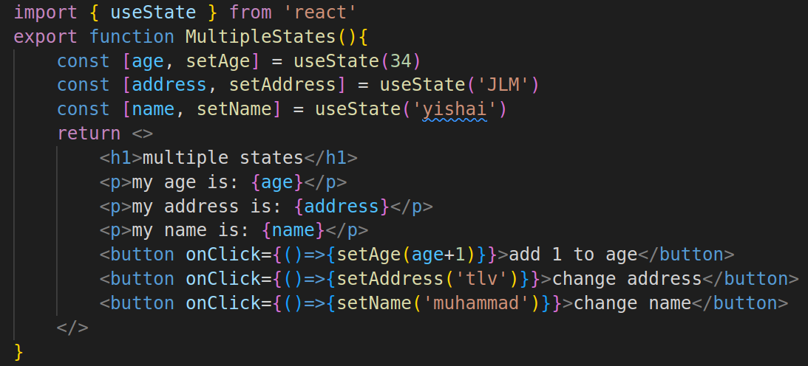
Multiple states
APPLESEEDS

Slide 17
Multiple states
APPLESEEDS
This can become very annoying very fast…
We can put all the states together: const [stateObj, setStateObj] = setState() <button onClick={()=>{setStateObj({name:”yishai”}, …stateObj{})}}></button>

Slide 18
/04
Form example
APPLESEEDS
INDEX.HTML

Slide 19
Form example
APPLESEEDS
A common example is to use setState to store values from a from.
This is only one way to do it, we will see later another way, with another hook (useRef)
demo

Slide 20
Thanks, and good luck!
Contact us:
Yishai
yishain@appleseeds.org.il
0524605642
Shadi
shhadys@appleseeds.org.il 0543113297
APPLESEEDS
INDEX.HTML

